Slide 1
Residential Care for Youth: A Positive Choice?
Gay Graham M.Litt PhD CQSW

Slide 2
What critical success factors are necessary and sufficient for provision of developmental care for each young person in residential child and youth care? ‘no informed conclusion about the future of residential care can be reached without some understanding and appreciation of those forces that have shaped its history’ –parker 1988: 3.

Slide 3
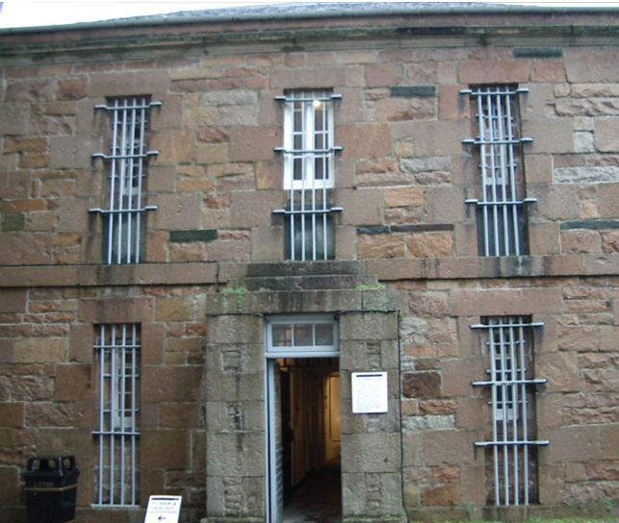
Historical Overview
Irish Poor Law system (1838) : Institutional Response, no outdoor relief
Catholic Church: consolidated institutional response
Industrial Schools Act 1868: separation of children from parents pursued relentlessly
105,000 children committed by the courts to industrial schools between 1868 and 1969
Harsh care regimes prevailed

Slide 4
Social Risk Model of Care
Children seen as a social risk, as a threat to society
Prioritised perspective of the system over that of the child
Staff encouraged not to relate with inmates
Segregation and Control were the aims
Aspects of former models can outlive the model itself

Slide 5
Developmental Model of Care
Current legislation mandates the provision of developmental (needs-led) care for all children
This requires a child welfare system with a ‘whole child/whole system’ perspective
The challenge is to provide primary (developmental) care in secondary (bureaucratic) settings (Maier 2006)

Slide 6
Needs-led Care
Share a common humanity
Individualised care
Reciprocal relationships
Shaped by common needs
Love and Security
New Experiences
Praise and Recognition (MK Pringle 1974)

Slide 7
Bureaucratic Structure (Secondary Care Setting)
Typified by an impersonal, rational orientation aimed at efficient administration (Weber ’47)
Routine tasks, formalised procedures guided by rules and regulations aimed at rigid control (Mintzberg 1988)
‘Organisational rigidity negates individuality’ (Maier (2006: 94).

Slide 8
Service Organisations
Main providers of residential youth care
Many have bureaucratic structures as they are accountable to the public for their actions
They must be seen to be fair
This leads to proliferation of regulations and a standardisation of tasks
Needs-led care is not predictable and cannot be standardised, so needs a different structure

Slide 9
Themes of Social Risk model
Prioritisation of compliance in frontline practice, not needs-led care as mandated in Irish legislation
Presence of a traditional view of residential CYC as being merely childminding
Strategic planning and development of frontline services were seen as the exclusive responsibilities of senior management

Slide 10
Developmental Care Themes
Workforce factors were managed by directors of frontline services with domain expertise
Directors of service had leadership skills that ensured commitment by all frontline staff to provision of need-led care by clarifying the purpose of residential CYC as provision of developmental care for residents
Strategic planning and development of the frontline service were practice-led

Slide 11
Critical Success Factor 1
Provision of developmental care in residential child and youth care practice requires reciprocal relationships which are needs-led, not regulation-led

Slide 12
Critical Success Factor 2
The senior manager (director of service) tasked with responsibility for the workforce in the residential youth care sector must have authority and proven domain expertise

Slide 13
Critical Success Factor 3
It is necessary to have accountable leadership with authority and developmental care expertise which is committed to a shared vision about the purpose of residential CYC and the provision of developmental care

Slide 14
Critical Success Factor 4
Strategic planning and service development in residential youth care need to be practice-led, guided by a shared vision of developmental care and ongoing evaluation

Slide 15
Critical Success Factor 5
Responsibilities of a duty of care mandated by the Child Care Act (1991) must be prioritised to ensure that bureaucratic inputs do not undermine developmental care in Irish residential youth care services

Slide 16
Concluding Comments
Provision of developmental care in organisational settings is possible where the design structure allows practitioners to:
exercise discretion
participate in decisions affecting their work
influence the pace of their work
The self contained task structure provides an environment suited to use of these elements of practice

