Slide 1
CYC “THE CLAN GATHERING” PAISLEY 19 March 2012

Slide 2
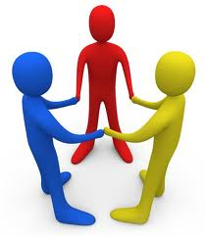
Fitting Kindness into the Future of CYC
Max Smart
Lothian Villa
East Lothian
Scotland

Slide 3
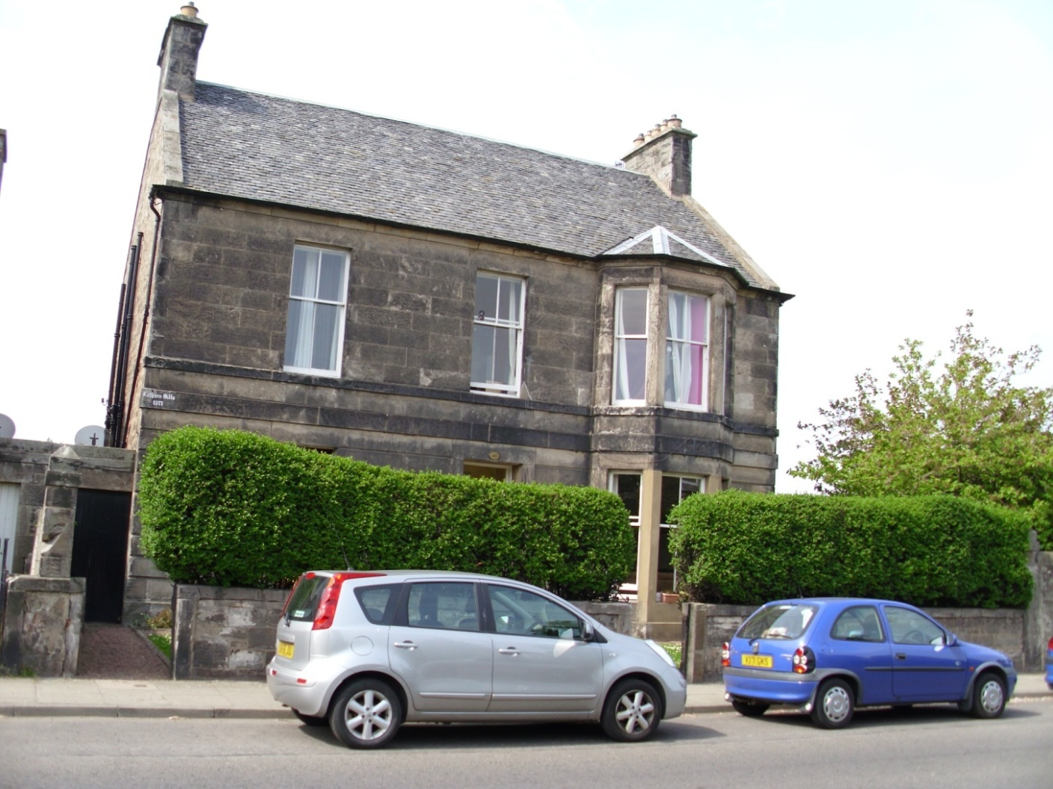
Lothian Villa

Slide 4
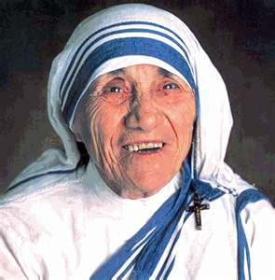
Unique, Special, and Different
“We cannot do great things on this earth, only small things with great kindness”
Mother Teresa
Notes:
Small things with great kindness. I started off my career in residential care with the idea of how potent practice in child care could be if we joined everything up, using the generic skills we had as practitioners to practice inside and outside the residential service. It was a grand idea, but as time has gone on I have grown to understand the wisdom of Mother Teresa’s words – and this input to the gathering is an attempt to place “kindness” at the heart of our profession.

Slide 5
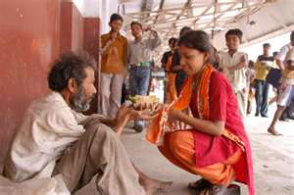
Essence of CYC
“Kindness is a behaviour driven by the feeling of compassion.
Compassion is an emotion that cannot be seen or touched, but can only be felt in our inner life.”
(Long,2007)
Notes:
Putting kindness at the heart of what we do may sound a bit gooey and sugary sweet, but I would assert that acts of kindness are the core of healing and development at the “core of care” as Henry Maier would have said. Acts that have so much meaning, taken from instinct but now validated by advances in n
neuroscience. I will go to talk of this validation during this presentation.
Compassion is closely linked to kindness. In compassion we share another’s pain, wish them free of suffering and as Hamilton (2010) advises “are then motivated to help them to be kind. Link to issue of tending instinct and the “Vagus nerve found in the brain.

Slide 6
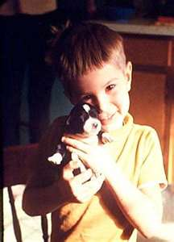
Kindness Neglected
“Staff kindness as an important therapeutic value has been neglected or disregarded in reclaiming troubled students”.
(Long, 2007)
Notes:
CYC environments have always been busy places. People and things come and go. Amid the day-to-day hub-bub of schedules and activities is the life blood of CYC work, relational care. Relationships that support and enable are at the heart of CYC, the ability to make sense of complex situations and respond to the needs communicated are essential to responding effectively, sensitively and appropriately.
Essential to effective care is the ability of CYC workers to create trusting relationships and I would argue that the key to the door of trust are basic acts of kindness. However like Long I would assert that kindness has been neglected by our field

Slide 7
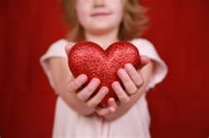
What’s Old – Is New
“Love includes kindness, generosity, nurturance, and the capacity to be loved as well as to love”
(Seligman, 2002)
Notes:
At a time when we are considering our future, considering something so huge, something small is so big, something so old is so new.

Slide 8
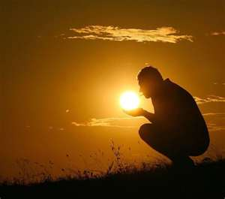
Kindness
“Kindness is envisioned as a vital force to our well-being and in our therapeutic work with troubled students. Just as sunlight is the source of energy that maintains organic life, Kindness is the source of energy that maintains and gives meaning to humanity.”
(Long, 2007)
Notes:
Some noted researchers in our field have been writing for years about kindness. Nicolas Long - long involved in the re-education movement in the US Brokenleg, in acts of generosity, Bosco on how kindness is a trait favoured in workers that can help those troubled, kindness is the source of energy in our field that can connect us relationally and develop trust.

Slide 9
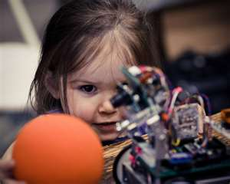
Kindness & Generosity
“A child draws from within us the inclination and instinct for kindness and gentleness and generosity and love. The child is a miracle of human nature, drawing out of us our sense of wonder.”
(Vilakazi, 1991)
Notes:
Attachment specialists in Scotland such as Sally Wassell asks practitioners to stimulate their curiosity with troubled young people. Kind acts can be a vehicle to enquire why a young person does what they do. Kindness becomes a bridge to overcome resistance, to build relationships.

Slide 10
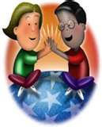
Generosity
“When real generosity occurs, the recipient feels nurtured and healing begins. In the process of reciprocal generosity, the community reaches out to those in need; the person befriended responds with generosity as well”
(Brokenleg, 1999 n.p)
Notes:
At the core of all emotional and behavioural problems are unmet needs. One of the four clear growth needs areas is generosity. Meeting this need area requires kindness and altruism, what Garfat and Fulcher (2008) refer to as reciprocal altruism. What you give out in kind generous acts comes back to you over time. Generosity is taught, modelled, encouraged, in the milieu, in the daily life of our young people. When all staff live with the children, acts of human kindness (Long, 1997) are spontaneous and evident throughout the program, (Marsten, 2001).

Slide 11
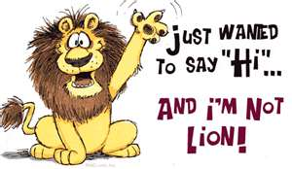
Saying Hello ....
“The voyage of the therapeutic child care relationship begins with that first step of "saying hello." How you take that step may well determine how the journey goes.”
(Garfat, 1989)
Journal of Child and Youth Care, 1989, Vol. 4(2), p v-viii

Slide 12
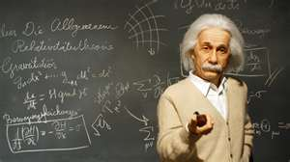
Valuing Kindness
“The value of a man resides in what he gives and not in what he is capable of receiving.”
Albert Einstein
Notes:
Placing kindness at the core of what we do models for young people that we all have the responsibility to demonstrate kindness. In todays dog-eat-dog world it demonstrates that we Valuing kindness.

Slide 13
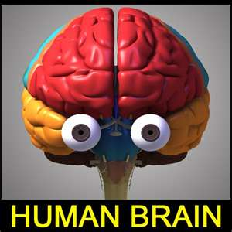
The Road Ahead
“Acts of kindness find their way into the chemistry and structure the brain”.
(Hamilton, 2010)

Slide 14
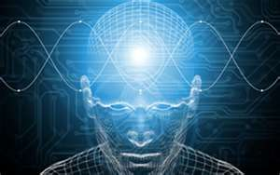
Genetically wired 2 B Kind
“The human brain and nervous system have evolved over vast periods of time in an environment of close cooperative contact with others, where kind behaviour was necessary for survival
... We are actually genetically wired to be kind”
(Hamilton, 2009)
Notes:
Relationships are at the core of CYC. They have been the footprints in the sand left by CYC forebears and are at the core of what we do today. Likewise the future will be located in a CYC future. Good relationships are associated with longer lifespans and have a direct bearing on notions of belonging. Human evolution is predicated upon our survival in social groups. Within the brain pleasure chemicals are released when we connect with others. When we connect with someone, oxytocin flows through our brain and body making as Hamilton advises... Us more trusting and more generous.

Slide 15
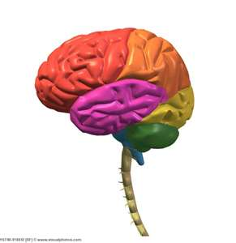
Changing Brains through kindness
“Whether you’re being kind or showing compassion you are changing your brain”.
(Hamilton, 2010)
Notes:
Neuroplasticity in the brain. The human brain & nervous system have therefore evolved over vast periods of time in environments of close co-operative contact with others. Kind behaviour has always been necessary for survival. Generosity to others feels good, it feels so good that there is now a term called helpers high to describe how acts of kindness promote good feeling and raise self-esteem. Generous acts not only raise self esteem but have a range of beneficial health benefits – better digestion, fewer colds, better sleep. It also generates brain growth.

Slide 16
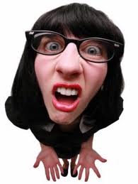
Opening the Mind
If I’m aware of only limited alternatives
I can make only
limited choices

Slide 17
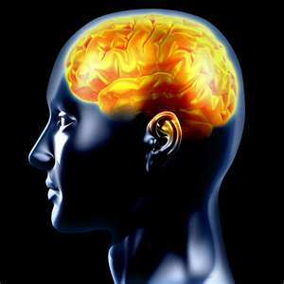
Why do Positive Emotions feel Good
“Oxytocin receptors are now being found all over the body...
“A picture is emerging of Oxytocin as a key component in a number of bodily systems, linking the mind and body in a way never before understood ...”
“This link goes some way to explain why love and kindness and compassion are so good for our physical health...” (Hamilton, 2010)

Slide 18
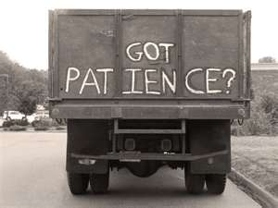
Traits of Good Workers
“Bosco ... learned, through experience, that kindness, tempered with patience, was an attractive trait, whereas rudeness, impatience, annoyance, and hypersensitiveness, were not. He realised, too, that to show equanimity to others, to have them interested in what was being said or done, one had to be friendly, kind, and charitable towards people.”
Notes:
Don Bosco founder of the Bosco schools based his educational philosophy on acts of kindness removing violent punishment.

Slide 19
Happiness for a Lifetime
If you want happiness for 1 hour – Take a nap. If you want happiness for 1 day – Go fishing. If you want happiness for 1 month – Get married. If you want happiness for 1 year – Inherit a fortune. If you want happiness for a lifetime – Be kind to others.

